Slide 1
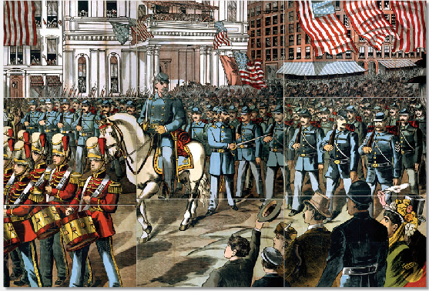
Look at this image. What details do you see?

Slide 2
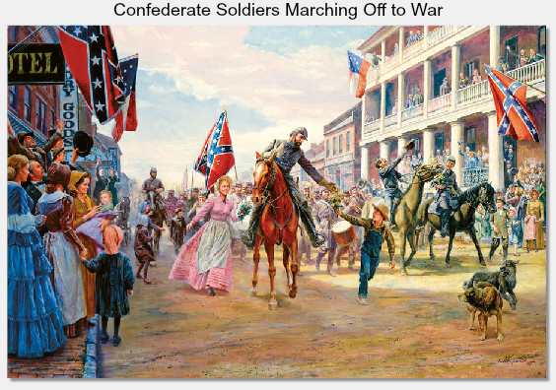
What details do you see in this image?

Slide 3
What differences do you notice between both images?

Slide 4
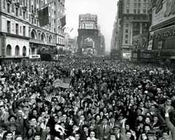
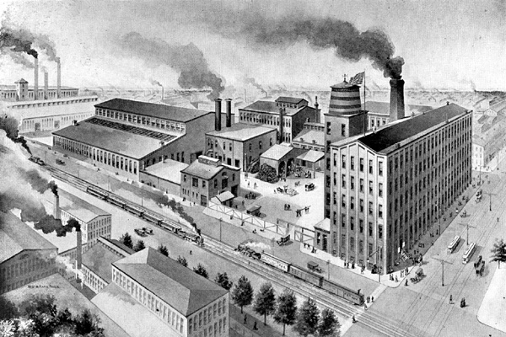
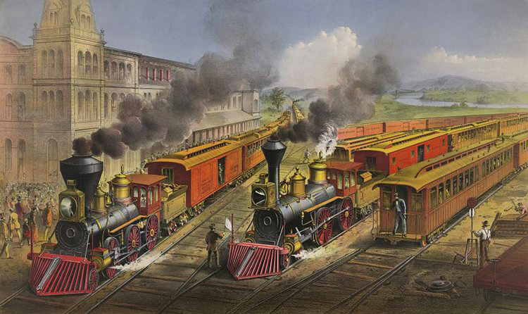
North’s Strength and Weaknesses
Larger population
More factories
Extensive railroads to transport soldiers and supplies
Controlled most of the banks
Weak military leaders

Slide 5
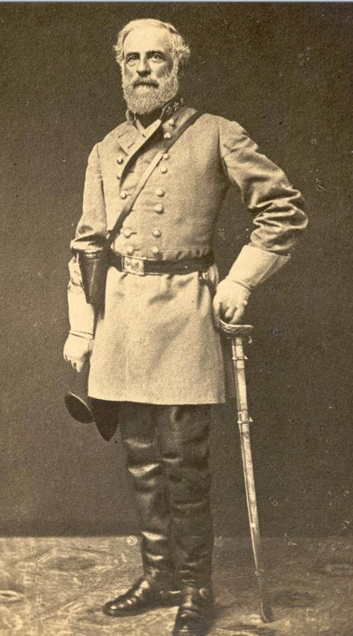
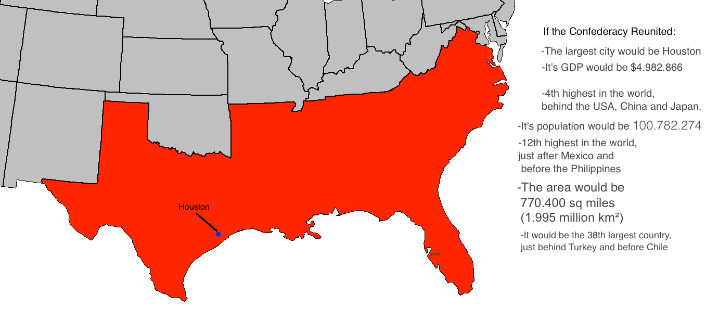
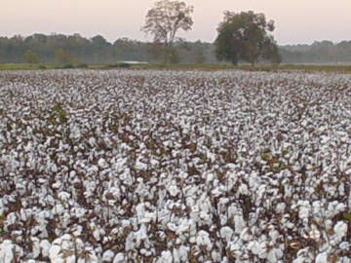
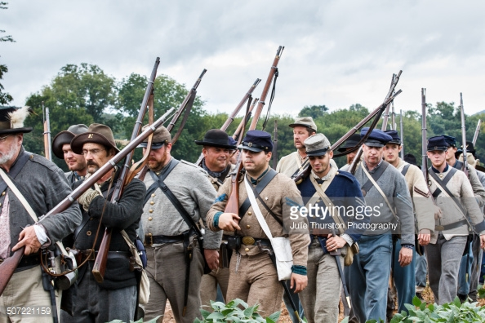
South’s Strength and Weaknesses
Large territory to invade and conquer
Too few factories for supplies
South only had to defend to win.
Strong military leaders
Limited transportation

