Slide 1
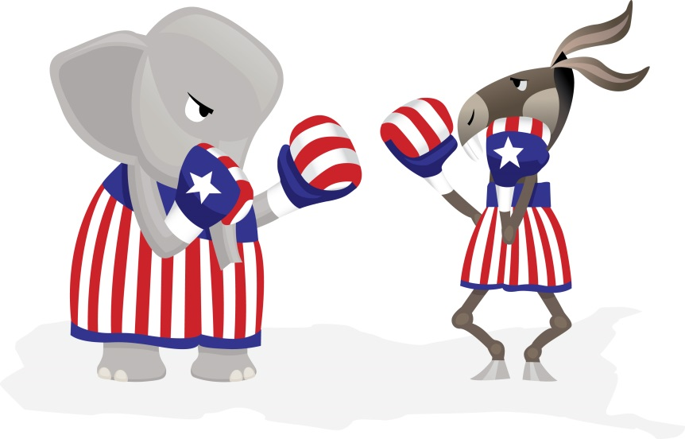
Election of 1860 vs Election of 2016
The election of 1860 divided the country.
Today we have the primaries, voting that will lead to the Presidential election in 2016, which is also dividing the country.

Slide 2
Non-Negotiables
Must have at least one person you interview (voting age adult) about what they feel are the most important issues of the 2016 election. See if you can get them to tell you who they are voting for.
You must write a minimum of one thousand words on the topic. This is to be submitted on online.
You must use a normal, easy to read font, which is no less than 10 point and no greater than 12 point.
You may not copy and paste or just provide links. It must be 100% your own work!
You must cite all sources reviewed in the course of “fact finding” for your project. Use only sites from the resource sheet.
It is due the Monday you return from Spring Break.

Slide 3
You will be graded on:
Did you interview your adult and ask all the questions that were required of you? – 10%
Did you completely discuss the issues that divided the United States during 1860 (federalism and slavery)?– 40%
Did you completely discuss the issues that are causing division in the United States currently (federalism and immigration)? – 40%
English conventions – 10%
BONUS – 10% if your project is turned in complete, high quality, and EARLY – by midnight the Monday of Spring Break (start of break).

Slide 4
Products Your Teacher is Offering
Build a website (You must already be able to do. I will not teach it. You will send me the link).
Design a newspaper (Online… send me the link).
Write an essay, handwritten or typed on Google docs.
Write a children’s book (Online… send me the link).
Write a play (You will send me a hard copy of the play, and then you will perform it – memorized and send me the link to see it.).
Others, if you discuss it with me beforehand and get it approved.

Slide 5
1860 vs 2016 Schedule
Tuesday - skeleton outline of what you plan to do is due before you leave today (hardcopy) or via email by midnight tonight via Google Docs. Submissions must have your first and last name, teacher, and period you have history.
Wednesday – research
Thursday – finish research and start project
Final day to work on project - due Monday that we return from Spring Break

