Slide 1
North Versus South
Reasons for the Civil War

Slide 2
What You Need to Complete This Section:
Blank map of the United States
Foldable
Pencil or pen

Slide 4
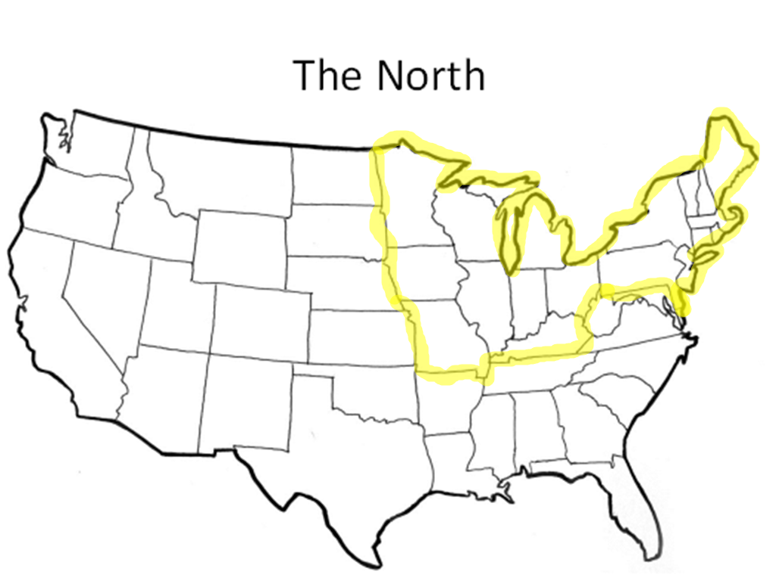

Slide 5
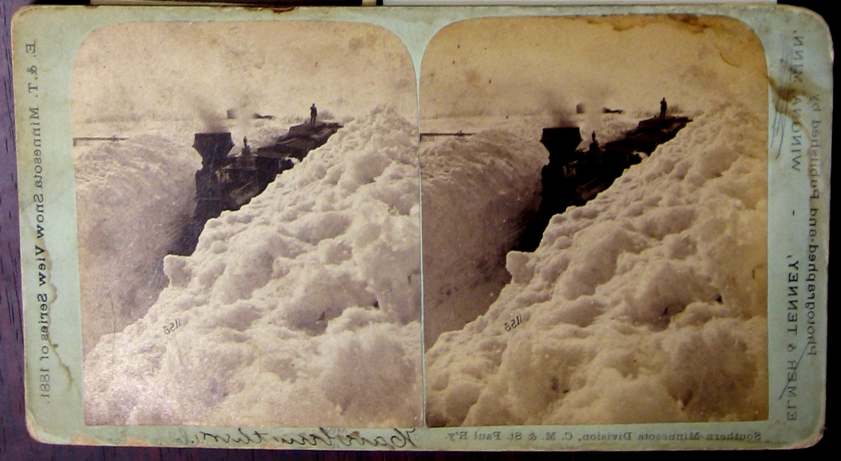
Geography of the North
http://pastispresent.org/wp-content/uploads/SnowLoco.jpg
Northern states all experience four distinct seasons, with freezing winters to hot, humid summers.
The states farther to the north experience colder, harsher winters and shorter summers and shorter growing seasons (Maine and Minnesota) than those closer to the mid-line of the United States (Pennsylvania and Ohio).

Slide 6
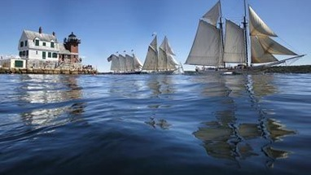
Geography of the North
Natural features of the Northern United States:
New England coast has hundreds of bays and inlets (perfect for ship harbors). Ship building and fishing were the major commerce.
http://cdn1.buuteeq.com/upload/4555/schooner.jpg.382x215_default.jpg

Slide 7
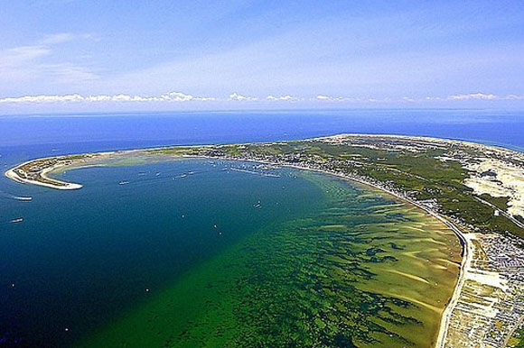
http://www.naturalcapecod.com/wp-content/uploads/2012/11/cape_cod2.jpg

Slide 8
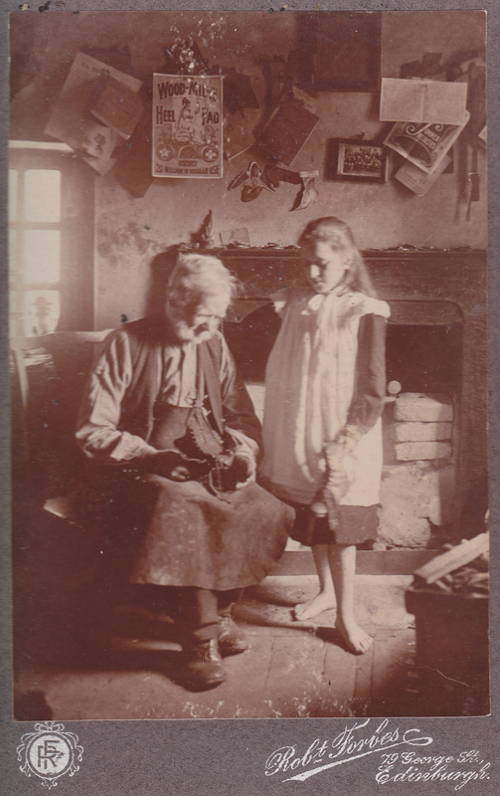
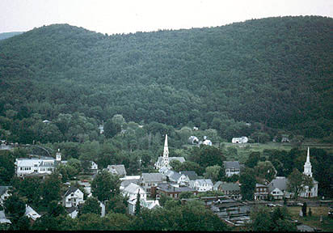
Geography of the North
Natural features of the Northern United States:
Inland from the coast were flat plains with rocky soil, not good for farming. This area developed trade crafts (cottage industry and later factories).
http://www.darklanecreative.com/uploads/2/1/1/5/21151136/2918008_orig.jpg
http://www.geog.nau.edu/courses/alew/ggr346/ft/e-highlands/ne-village.jpg

Slide 9
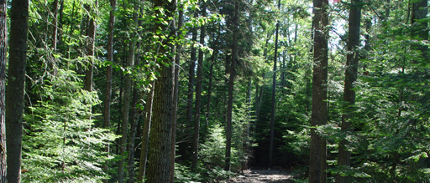
Geography of the North
Natural features of the Northern United States:
Still further inland were forests of spruce and fir (trees). Timber harvesting was a major source of revenue. The lumber was used for ship building and trade with other countries. Once the area was deforested, coal and other minerals lead to a huge increase in mining. (Pennsylvania especially)
Last of the Mohicans (show first minute)
http://www.fws.gov/uploadedImages/Region_5/NWRS/North_Zone/Moosehorn_Complex/Aroostook/Images/ForestPage.jpg

Slide 10
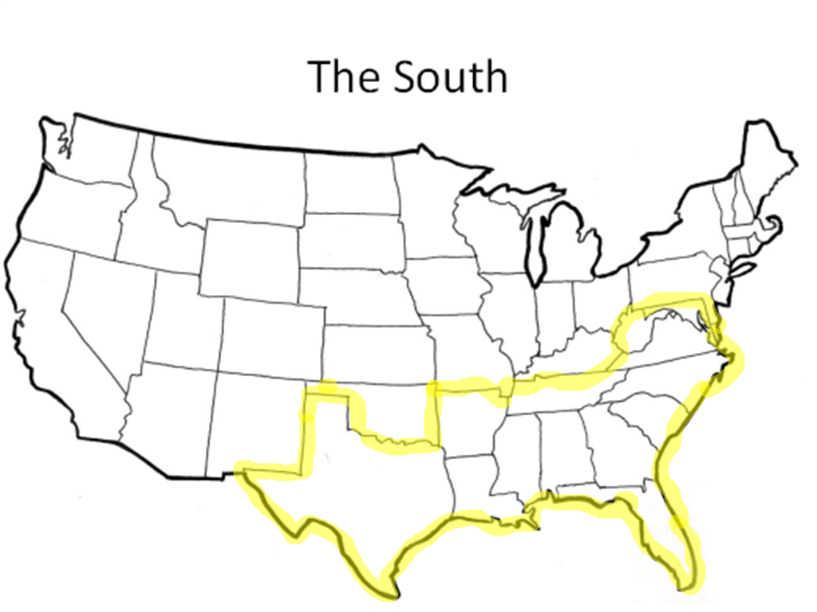
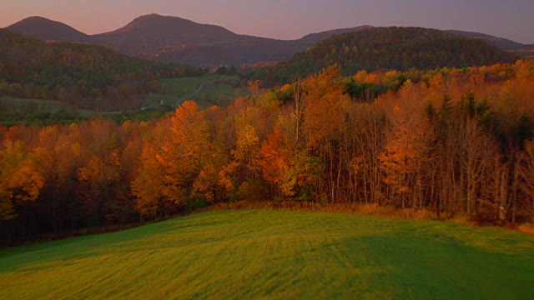
Geography of the North
Natural features of the Northern United States:
Further south (still in the Northern United States) there was rich soil from river (silt) deposits. These areas were good for farmland. (Southern New York, Pennsylvania, New Jersey and Delaware)
http://cache3.asset-cache.net/xd/666-69.jpg?v=1&c=IWSAsset&k=2&d=2DF30557A92EF68A07B7DE07603C49D886871D979DBBA8364D104297889386B4810F755E003CBEB8

Slide 11
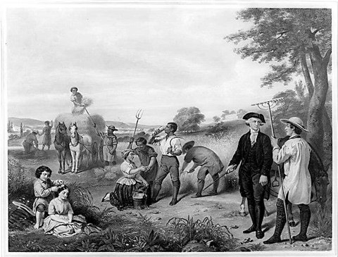
Geography of the South
The South is defined as the area from Maryland to Florida and from the Atlantic Coast to Texas.
The Southern United States have mild (to non-existent) winters and LONG, HOT, humid summers.
Lots of rain and a long growing season make this area ideal for agriculture.
http://www.crf-usa.org/images/stories/bhm/bhmwashingtonfarmer.jpg

Slide 12
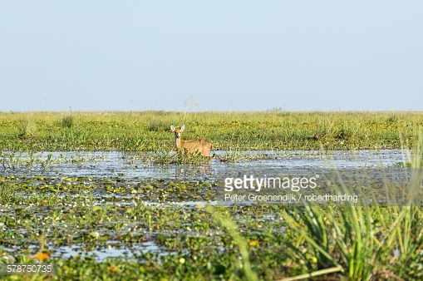
Geography of the South
Natural features include:
Wide coastal plains line the shore line of the Southern United States from Chesapeake Bay to the Gulf of Mexico. These make for 300 miles of fertile lowlands.
http://cache4.asset-cache.net/gc/578750735-rare-pampas-deer-grazing-in-swamp-ibera-gettyimages.jpg?v=1&c=IWSAsset&k=2&d=mMbGfX8N7dVV6blX0LU2a%2FmbWxSAVIjaewOq0U0p0EMehoA1IOkpS4zHtzbX4ORYoF9hApfSlTes65awxfTctdDQr7x%2Ft%2BimNhootbNLlwQ%3D

Slide 13
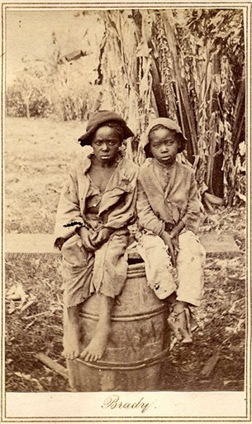
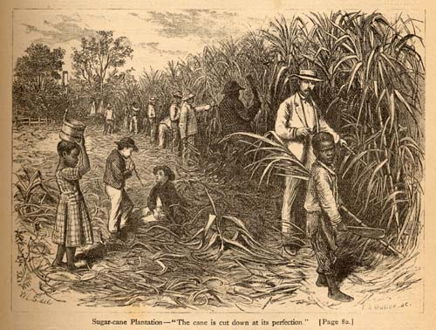
Geography of the South
Natural features include:
Swamps and marshes dot the plains along the coast. This land is idea for growing rice and sugarcane. Also, indigo is grown in the dry land above the swamps.
http://docsouth.unc.edu/nc/king/king083.jpg
https://upload.wikimedia.org/wikipedia/commons/8/88/SlaveChildrenUnknown.jpg

Slide 14
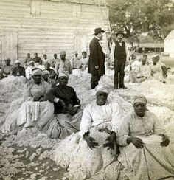
Geography of the South
Natural features include:
Further inland from the coast is soil ideal for growing tobacco, cotton, and corn.
https://s-media-cache-ak0.pinimg.com/236x/26/b3/62/26b3623b58f1c1e6f2529e06924b7c54.jpg

Slide 15
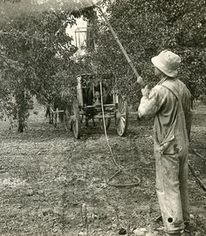
Geography of the South
Natural features include:
North of the plains of the South are the Appalachian Mountains. This is an ideal place for fruit orchards.
https://s-media-cache-ak0.pinimg.com/236x/90/cf/0e/90cf0edfca1f41f0b707d55912287165.jpg

Slide 16
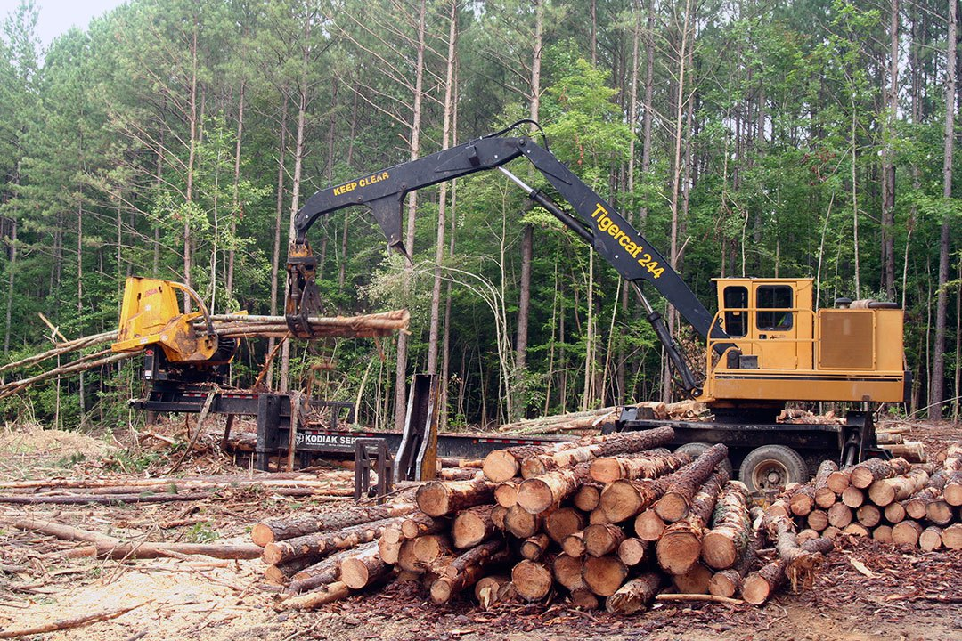
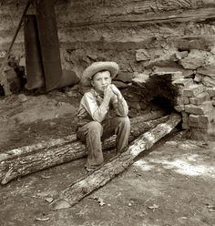
Geography of the South
Natural features include:
Along the Eastern coast of the South are great pine forests. Lumber harvesting was a sub-economy here. (North Carolina).
https://s-media-cache-ak0.pinimg.com/236x/40/1d/33/401d333ffc3bbdcc2e0413a8745f57c7.jpg
http://i0.wp.com/media.southernloggintimesmagazine.com/wp-content/uploads/2013/12/Harmon_8502.jpg

Slide 17
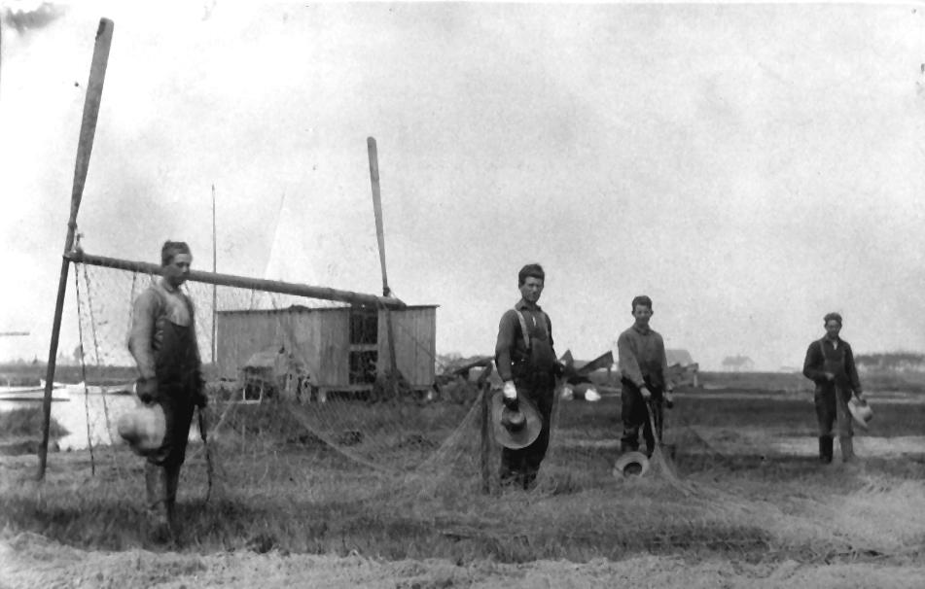
Geography of the South
Natural features include:
From the Chesapeake Bay in Virginia and in Maryland fishing is another source of revenue: fish, oysters, and crabs.
http://caseytodd.com/HollandIslandPictures/IraToddandGeo.WebsterTodd.jpg

Slide 18
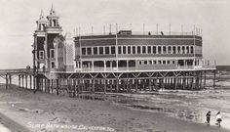
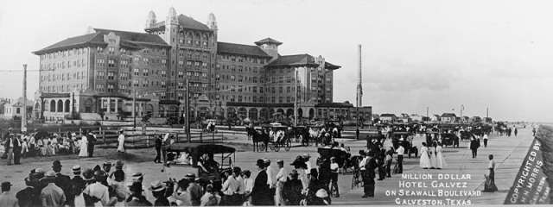
Geography of the South
Galveston, Texas is the only deep water port between New Orleans, Louisiana and Tampico, Mexico.
https://s-media-cache-ak0.pinimg.com/236x/4d/33/30/4d33301b7d4ef5f6309d1fe07fbd1d12.jpg
https://res.cloudinary.com/roadtrippers/image/upload/w_640,fl_progressive,q_60/v1405290247/soud16wu4ps7abfkndmj.jpg

Slide 19
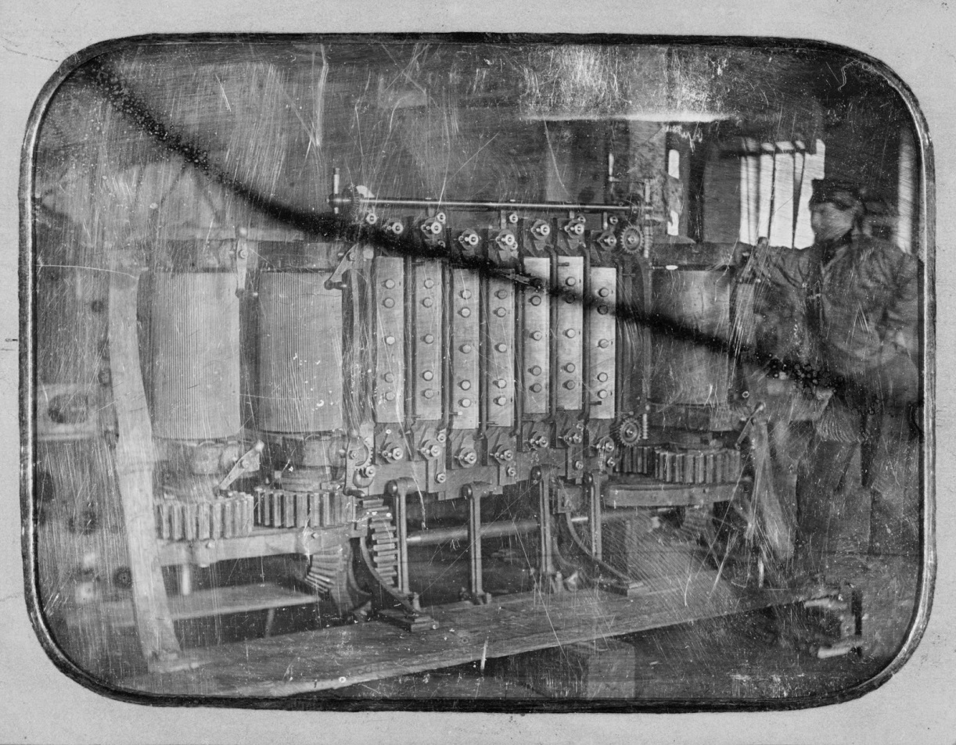
Economy of the North
Driven by the Industrial Revolution.
Cottage industry is replaced with large factories.
New inventions and manufacturing made goods cheaper and more plentiful.
You could use workers who were not skilled craftsmen.
No labor laws, minimum wage law, or safety standards.
Factory owners favored a strong national/federal government that promoted improvements in manufacturing, trade, and transportation.
http://4.bp.blogspot.com/-a4Iz8IEbVus/VSHaiyl0l_I/AAAAAAAAEdU/jFvVT9_UVcU/s1600/dag%2Bsteam%2Bengine.jpg

Slide 20
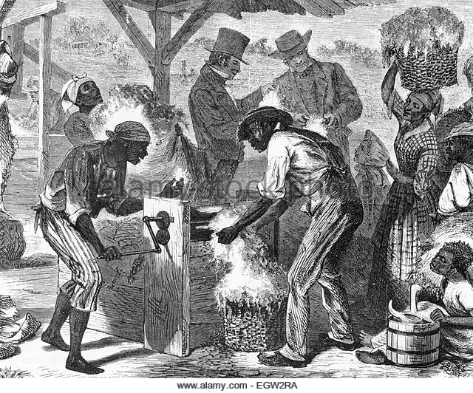
Economy of the South
Agrarian (farming) way of life.
Cash crops were: tobacco, rice, cotton, sugarcane, and indigo.
1790s, slavery was declining – Europeans would not pay high prices for cash crops of tobacco and rice, which they could purchase cheaply from British colonies.
Cotton was a promising crop, but the cost of removing the seeds made it unprofitable until the invention of Eli Whitney’s cotton gin. One slave could clean as much cotton in one day as 50 had done before the cotton gin’s invention.
https://www.google.com/search?q=eli+whitney%27s+cotton+gin+daguerreotype&safe=strict&espv=2&biw=1517&bih=714&source=lnms&tbm=isch&sa=X&ved=0ahUKEwiFptet7InLAhUCPiYKHW2WDJYQ_AUIBigB&dpr=0.9#imgrc=uDAUfMNh5T6LEM%3A

Slide 21
Technology and Transportation of the North
Factory owners needed to get goods to markets fast.
John C. Calhoun got Congress to build a system of roads and canals to “bind the republic together.”
Robert Fulton’s steamboats made river travel faster.
Erie Canal was the first all water link between fames in the Central Plains and East Coast cities.
Steam powered locomotives also closed the distance gap; the North had more than 20,000 miles of rail, compared to the South’s 9,500 miles of rail, in 1860.
There were 50,000 miles of telegraph lines in the United States by 1860.

Slide 22
Technology and Transportation of the South
South used primarily water to ship their goods (river or ocean).
Plantations had docks where cotton would be loaded onto steamboats and taken to market.
Farmers used ports along the South’s coastline and the Mississippi, and when that was not possible, they used their rail lines.

Slide 23
Societal Culture of the North
7 out of 10 people lived on farms and were neither rich or powerful.
Increased movement to cities, however. 1800 there were 33 cities with a population of at least 2,500. By 1850, there were 237 cities with a population of at least 2,500. By 1860, over a million people lived in New York.
Except for Chicago and Detroit, these cities were along the East Coast.

Slide 24
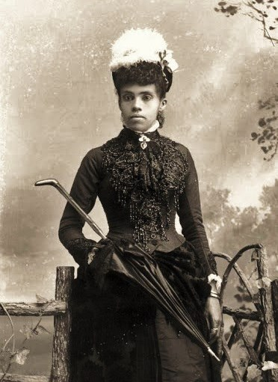
Societal Culture of the North
African-Americans were technically free in the North, but they were not treated equally. In most states, they could not vote, hold office, serve on juries, or attend white churches and schools.
African-Americans formed their own churches and started their own businesses. They often worked as laborers or servants, because few employers would give them skilled jobs.
http://publicpleasuregarden.blogspot.com/2013/08/african-americans-1800s-public-pleasure.html

Slide 25
Societal Culture of the South
Not greatly affected by Jacksonian “equality and opportunity” or the reform movements of the mid-1800s.
Wealth was measured in how much land and how many slaves you owned.
Rigid social structure: rich plantation owners at the top, white farmers and workers in the middle, and enslaved persons at the bottom.
Churches in the South defended slavery, while churches in the North said it was “un-Christian”.

Slide 26
Societal Culture of the South
Wealthy plantation owners dominated the economy and political power in the South. Life was easy for them, and their sons were sent to college. Daughters received little education, but were raised to be wives and mothers.
Most white families owned some land, but only about one in four people owned even one slave; most worked their own land.
Ten percent of whites were too poor to own land; they rented land, paid for in the crops they raised. Many white children were illiterate; public schools were few and far between.

Slide 27
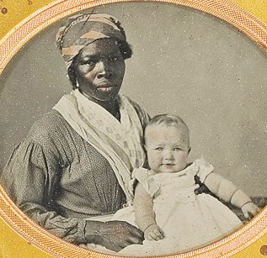
Societal Culture of the South
Free African-Americans were often forced to wear special badges, pay extra taxes, and live separately from whites.
Most lived in towns and cities, where they worked as skilled craftsmen, servants, or laborers.
Slaves worked as cooks, carpenters, blacksmiths, house servants, nursemaids, or field hands.
http://2.bp.blogspot.com/-qHz_vQeB4tc/UDQ65TcJN2I/AAAAAAABDZY/dD2HyAZ8yPA/s1600/27.jpg

Slide 28
Problems for the North
Immigrants
Working conditions in the North
Unions
Strikes
Overall issues in the big cities

Slide 29
Immigration Information
During the 1840s and 1850s about 4 million refugees arrive in the U.S.
The vast majority of immigrants were Protestant Christians, except the Irish, who were primarily Catholic Christians

Slide 30
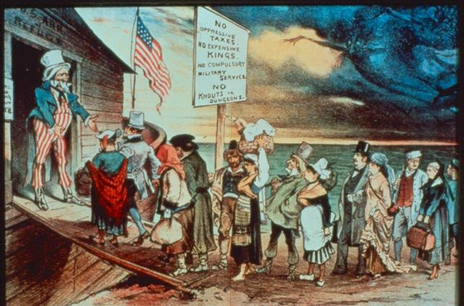
http://www.freerepublic.com/focus/bloggers/3244661/posts

Slide 31
Irish Immigrants
In the 1840s, over 1 million people died in Ireland due to the Irish Potato Famine
By 1860, over 1.5 million Irish immigrants came to the U.S. because of the famine
Most Irish immigrants came to the U.S. poor, settling in either Boston, New York, or Philadelphia

Slide 32
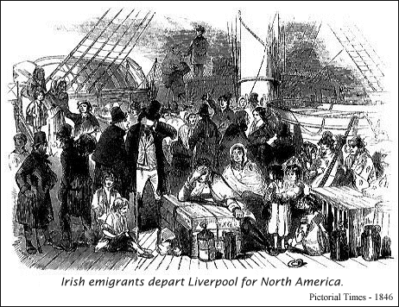
http://www.historyplace.com/worldhistory/famine/thp-mersey.gif

Slide 33
German Immigrants
German immigrants came to the U.S. to escape war and to better their lives
Those with money bought farms in the Midwest, and those who were too poor to buy land stayed on the East Coast in cities such as New York

Slide 34
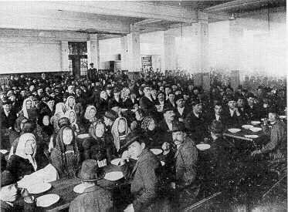
http://maxkade.iupui.edu/adams/images/illus12.jpg

Slide 35
Southern and Eastern Europeans
The total of immigrants amounted to about 24 million between 1880-1920, from Italy, Russia, Poland, Croatia, Greece, Czechoslovakia, and Hungry
They immigrated because of low wages, unemployment, forced conscription into the military, religious persecution and disease
Most were illiterate in their own language, and they most certainly could not speak English

Slide 36
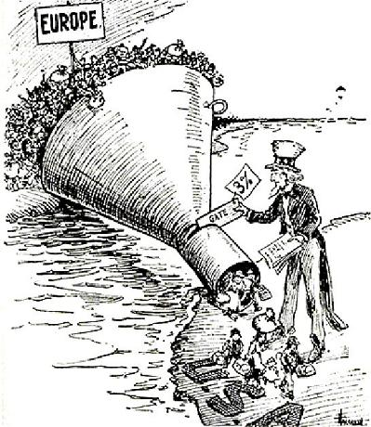
http://www.johndclare.net/images/ImmigrationQuota1921.JPG

Slide 37
Chinese Immigrants
Those who immigrated were primarily males, unlike the Europeans, who immigrated as a family
Their plan was to return home after earning money
They performed manual labor in mines, the railroad, etc.

Slide 38
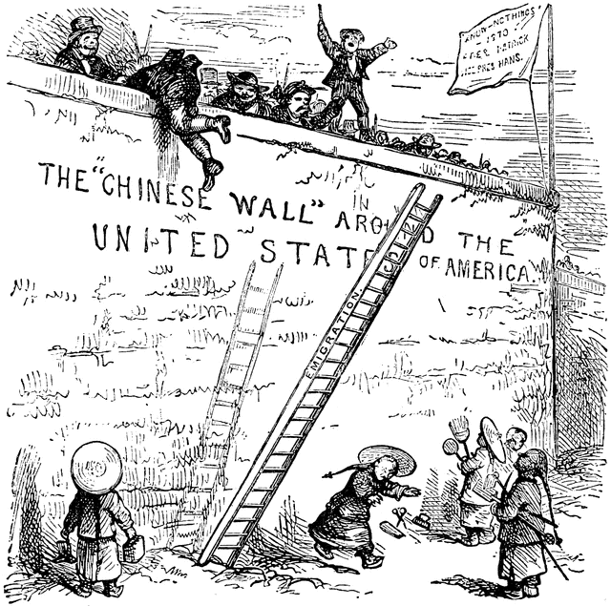
http://etc.usf.edu/clipart/67300/67396/67396_chin_wall_md.gif

Slide 39
Effects of Immigration
Immigrants took available jobs in factories and mines, helping the economy
Nativists (people who didn’t want immigrants to come to America) tried to limit immigration, blaming immigrants for “stealing” jobs from native-born Americans and for being criminals
Immigrants were also discriminated against for being Catholic

Slide 40
In the 1850s, the Nativists started the Know-Nothing Party
Immigrants primarily took low paying jobs and lived in communities that supported their native language. These areas were overcrowded and had poor sanitation, which led to liter, disease, and a general stench. Crime was also high in these areas.
The U.S. made new restrictions that kept illiterate, mentally unstable, and other unwanted people out.

Slide 41
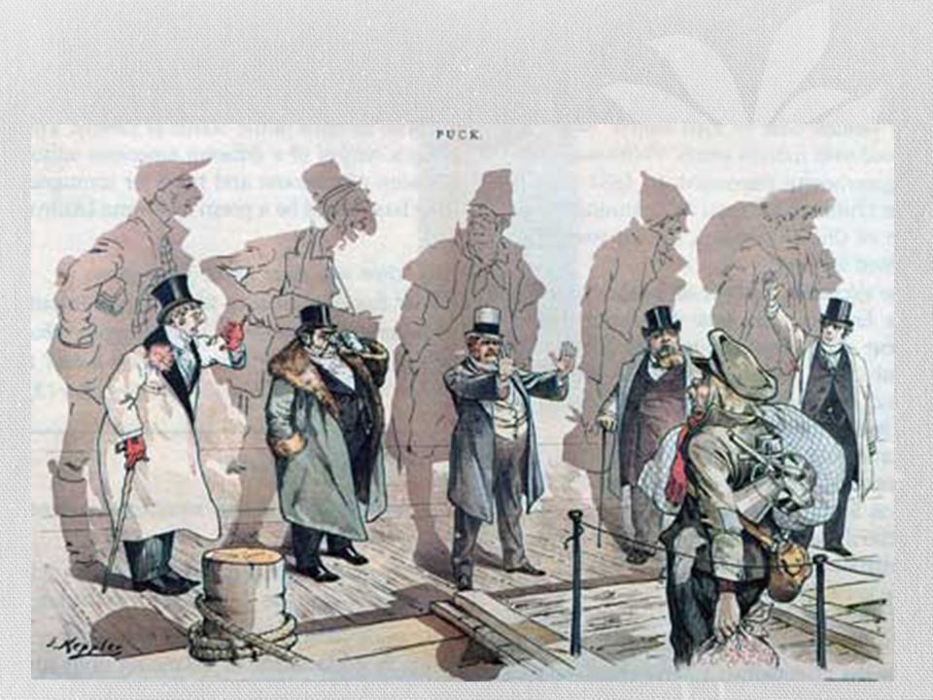
http://images.slideplayer.com/10/2760278/slides/slide_7.jpg

Slide 43
Effects of Factory Growth
Factory workers often worked 15 hours or more a day.
Injuries were common and wages were low. Earnings: Men - $5/week, Women - $2/week, and Children - $1/week
Factories began to replace skilled workers, such as carpenters and shoe makers
By the 1830s, workers began to form trade unions in order to fight for better working conditions
Union workers sometimes made their demands by going on strike

Slide 44
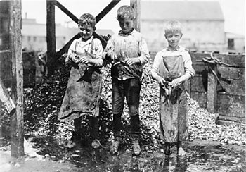
There were no child labor laws. Many children went to work because their families needed the money; they did not get an education.
http://www.studyzone.org/testprep/ss5/b/Hines.jpg

Slide 45
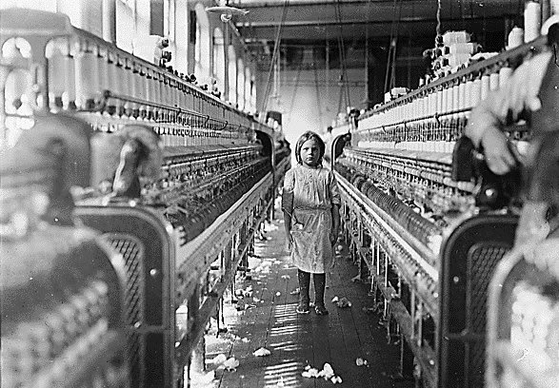
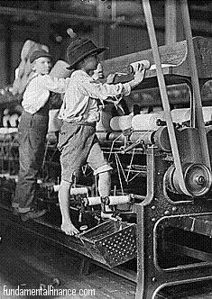
http://www.fundamentalfinance.com/images/child-labor-2.jpg
http://i260.photobucket.com/albums/ii18/drmabuse06/childlabor.jpg

Slide 46
Labor Unions
Uriah Stephens/ Terrance V. Powderly – Knights of Labor – Philadelphia – 1869 – organizing labor, recruited people who had been kept out of trade unions; grew rapidly

Slide 47
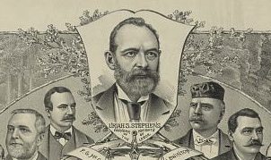
http://philadelphiaencyclopedia.org/wp-content/uploads/2013/08/Knights-of-Labor-cropped.jpg

Slide 48
Labor Unions
Samuel Gompers – American Federation of Labor – 1881 – pressed for higher wages, shorter hours, better working conditions, and the right to bargain collectively with employers; violent strikes turned public opinion against them; 1.6 million members by 1904

Slide 49
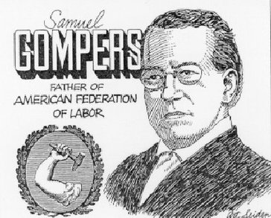
http://strikes-and-labor-unions.weebly.com/uploads/2/8/6/2/28627513/844343352.jpg?364

Slide 50
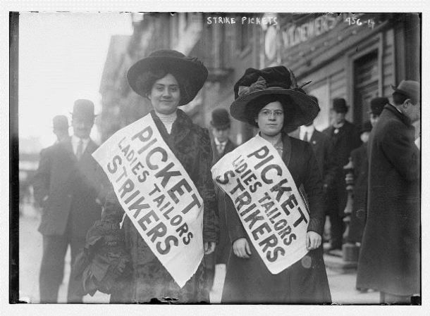
Labor Unions
Mary Harris Jones – International Ladies’ Garment Workers Union – New York City – 1911 – safer working conditions – result of Triangle Shirtwaist Factory Fire
http://connecticuthistory.org/wp-content/uploads/2014/11/WomenStrikers-610x449.jpg

Slide 51
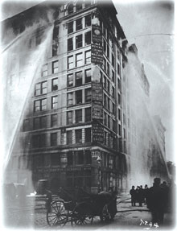
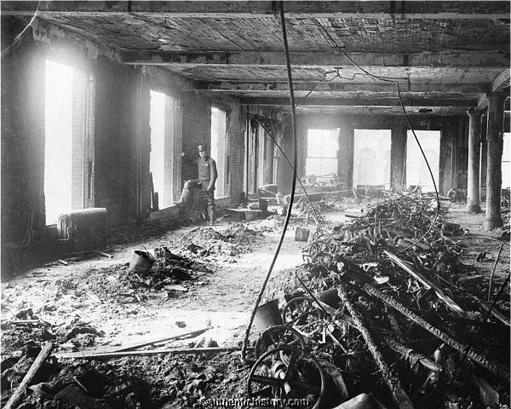
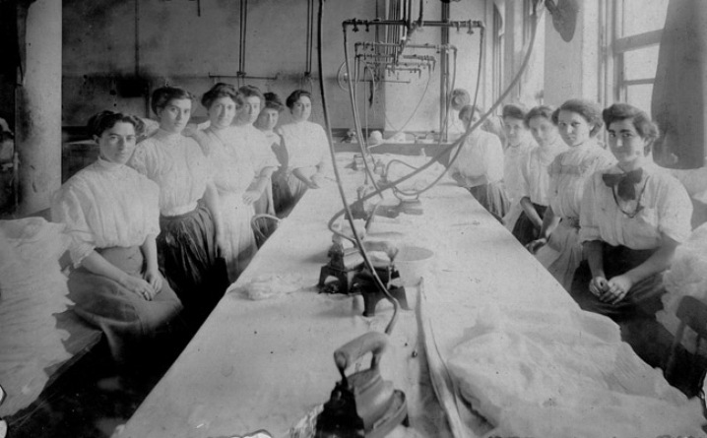
http://equalvisibilityeverywhere.org/wp-content/uploads/2011/03/Triangle-Shirtwaist-Fire.jpg
http://www.authentichistory.com/1898-1913/2-progressivism/3-laborreform/3-trianglefire/Photograph-Ruins_02.jpg
http://newshour-tc.pbs.org/newshour/wp-content/blogs.dir/1/files/slideshow/new_women_slideshow.jpg

Slide 52
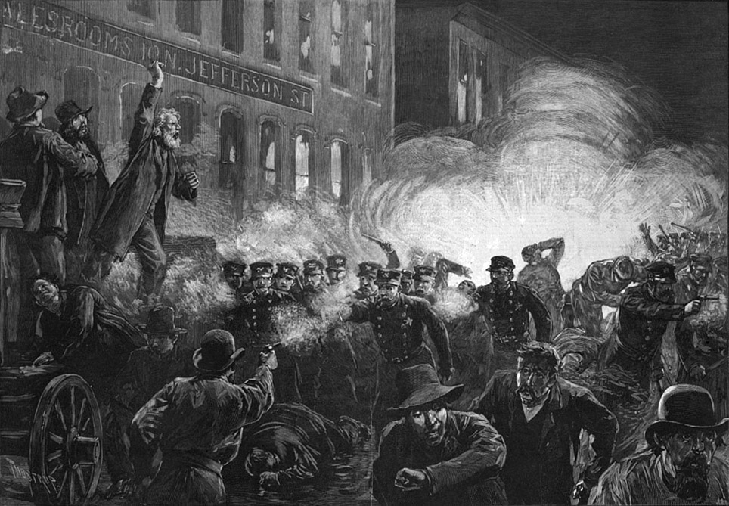
Strikes and Movements
Haymarket Square Riot – labor rally ends in violence, workers strike to protest the killing of four workers from the day before – Chicago, Illinois – 1886
https://upload.wikimedia.org/wikipedia/commons/6/61/HaymarketRiot-Harpers.jpg

Slide 53
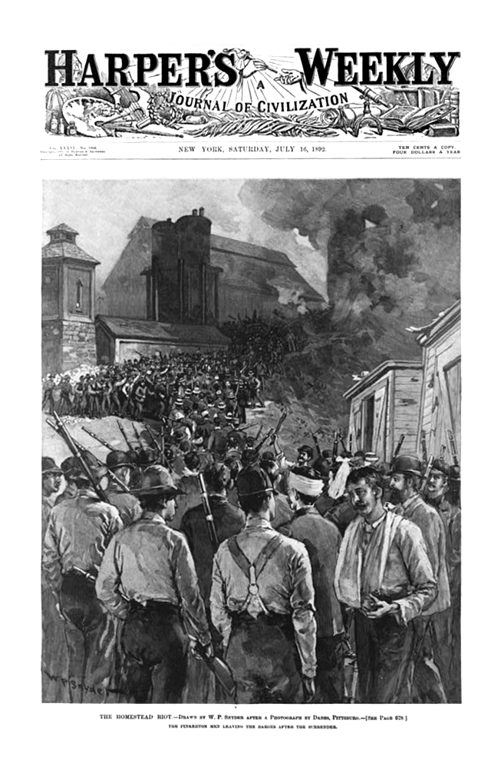
Homestead Strike – steelworkers protest wage cut – wages were cut to weaken the union – managers hired non-union workers and hired armed guards to protect them – governor brought in state militia to restore order – Homestead, Pennsylvania - 1892
https://citelighter-cards.s3.amazonaws.com/p172qlc5s71uf71ocu1u1s1v0r123i0_17261.png

Slide 54
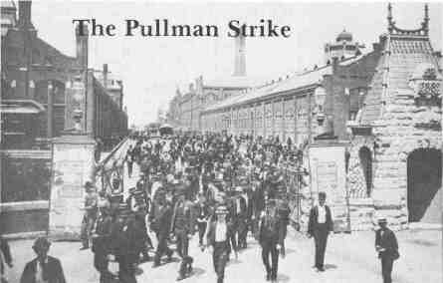
Pullman Strike – company cut wages and plant was closed for a month – American Railway Union supported strikers and refused to handle Pullman cars paralyzing rail traffic – U.S. Attorney General, Richard Olney, got an injunction to stop them – Eugene V. Debs refused to comply and was jailed – President Grover Cleveland called in federal troops to quell (stop) the riots – Pullman, Illinois - 1894
http://www.lib.niu.edu/1994/ihy9412081.jpg

Slide 55
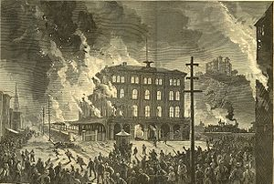
https://en.wikipedia.org/wiki/Great_Railroad_Strike_of_1877#/media/File:Harpers_8_11_1877_Destruction_of_the_Union_Depot.jpg
Great Railway Strike of 1877 – workers protest wage cuts – Martinsburg, West Virginia – 1877

Slide 56
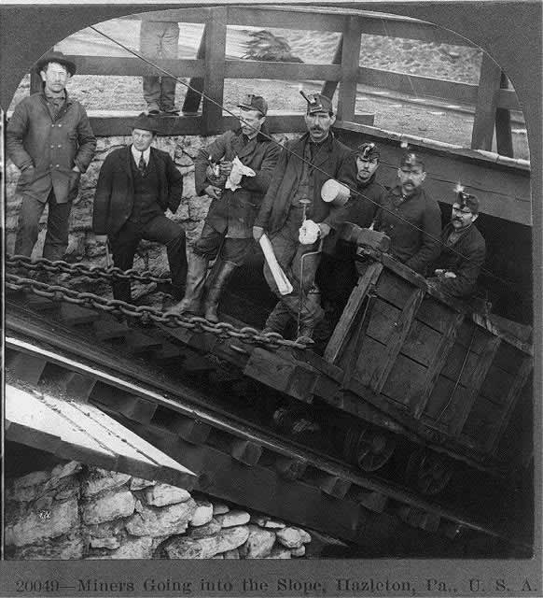
Anthracite Coal Strike – miners strike to win union recognition – Scranton, Pennsylvania – 1902
http://pabook2.libraries.psu.edu/palitmap/Coal1902Miners.jpg

Slide 57
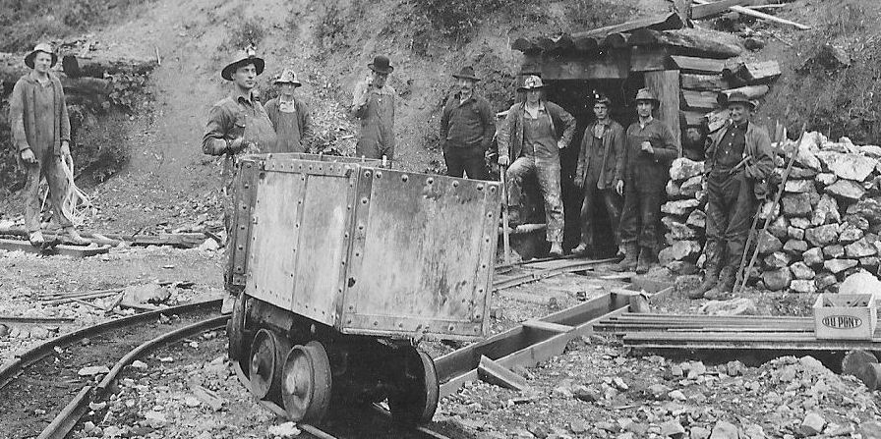
http://www.miningartifacts.org/Silver_Mine_-_Kellogg__Shoshone_County__ID_2.jpg
Silver Mine Unrest – state jails full of hundreds of striking workers – from forty-two unions – striking for shorter hours and better pay – New Orleans, Louisiana - 1892

Slide 58
Problems for the South
Raising cotton in the same fields year after year soon striped the soil of needed nutrients.
Whitney had hoped his invention would lighten the work load for slaves, but instead it made slavery more important than ever.
Southerners put their money into land and slaves. There was very little interest in building factories.

Slide 59
All of This Leads to…
Sectionalism
Protective tariffs
Slavery “needs”
States versus Federal Rights
… Which will lead us to the Civil War

Slide 60
Other Names for the Civil War
War of Northern Aggression
War Between the States
War of Rebellion
Great Rebellion
Freedom War
War of Secession
War for Southern Independence

Slide 61
Sectionalism
Extreme pride in and attention to your local area of interest (economic, political, social, geographical)

Slide 62
Protective Tariffs
Designed to protect domestic economy (industry) by taxing imports.

Slide 63
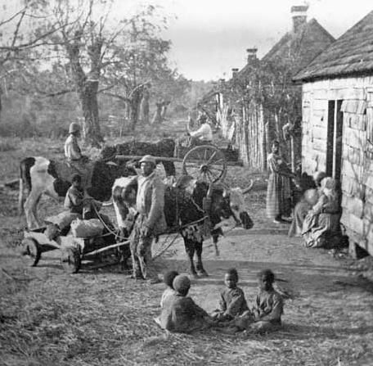
Slavery
The act of subjecting (putting a person under you to control them) a person without pay.
https://s-media-cache-ak0.pinimg.com/564x/b5/24/87/b52487b1c66e5f218263729b917d2e31.jpg

Slide 64
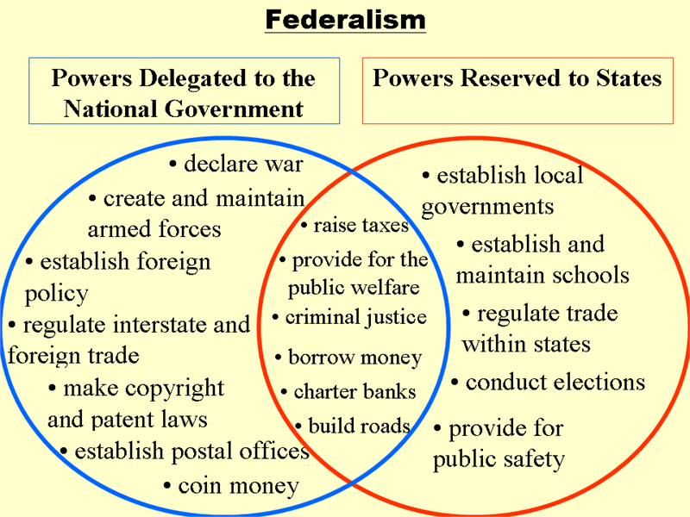
States Rights Versus Federal Rights
This ongoing issue revolves around how much power to you give the federal (national) government, and how much you keep for yourself or your state government.
Strong state government supporters want to limit the control of Congress and adhere to a strict interpretation of the Constitution.
Strong federal government supporters are fine with a broad interpretation of the Constitution.
Started with the Federalists and Anti-Federalists.
https://mihalakas.files.wordpress.com/2011/08/us-federalism-3.png

Slide 65
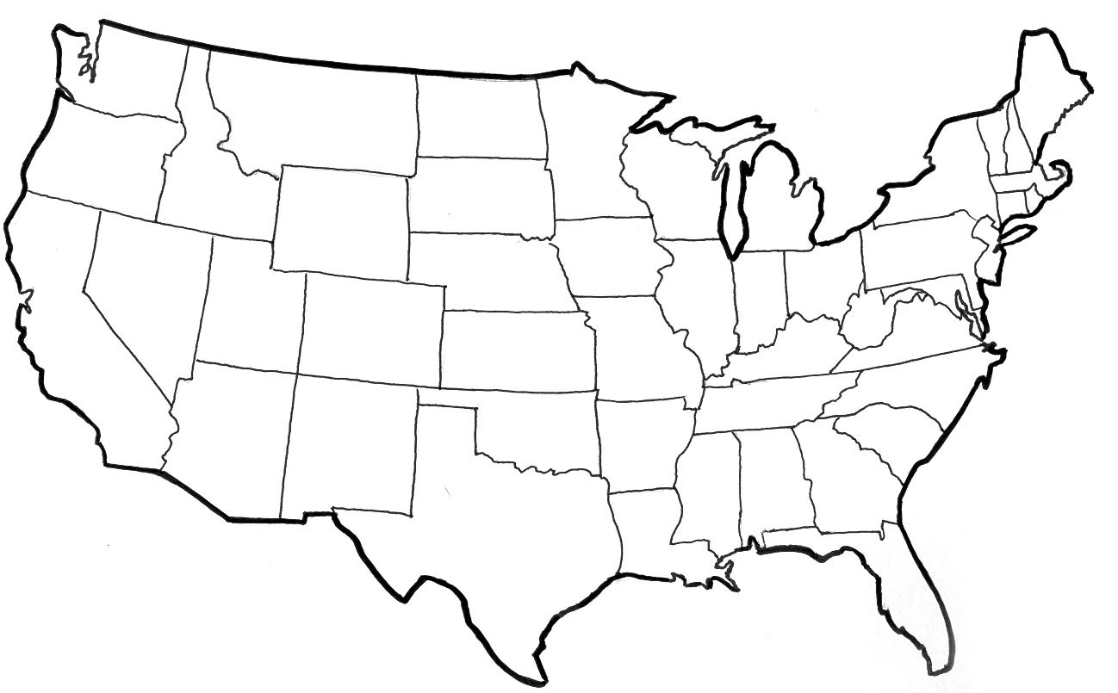
The West

