Slide 1
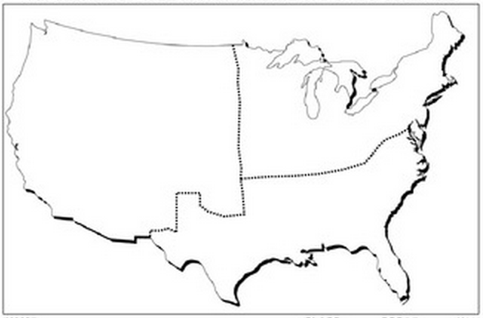
Using the information from the presentation, create a map with images and labels that represents the differences in each region of the U.S.

